Slide 1

MINI PROJECT (2020-2021)
EMPLOYEE RECORD MANAGEMENT SYSTEM
Institute of Engineering & Technology
Submitted by -
Astik Singh
Divyanshu Mittal
181500158
181500227
Supervised by :-
Mr. Pankaj Kapoor
(Assistant Professor)

Slide 2

Introduction
What is ERMS
Objectives of our Project
Proposed System
Home Page
Employee Registration Form
Feedback Form
Advantages
System Compatibility

Slide 3

In this world of growing technologies, everything is becoming computerized.
Employee Record Management System (ERMS) is an application that enables users to create and store employee records.
This application is helpful to the department of an organization which maintains the data of employees related to an organization.
It is simple and user-friendly and can perform many operations.

Slide 4
What is ERMS?
Employee Report Management System(ERMS) is a distributed application, developed to maintain the details of the employees working in an organization.
The ERMS has been developed to override the problems prevailing in the practicing manual system.
It maintains the information about the personal and official details of the employees.

Slide 5
Objectives of our Project
This project aims to simplify the task of maintaining the records of the employees working in a company.
To develop a well-designed database to store employee information.
Provides full functional reports to the management of the company.
The objectives of this project is to provide a comprehensive approach towards the management of employee information.

Slide 6
Proposed System
Helps in maintaining the computerized employee details.
Easy attendance marking.
Easy calculation of various leave in categories.
Computerized events and requests management.
Creates new users to the system accordingly.

Slide 7
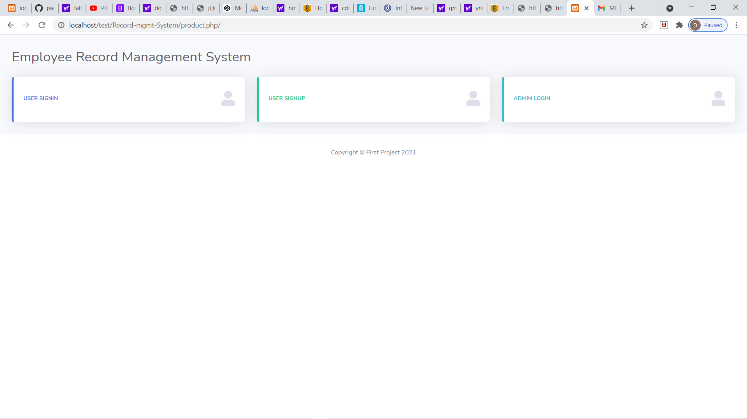
Home Page

Slide 8
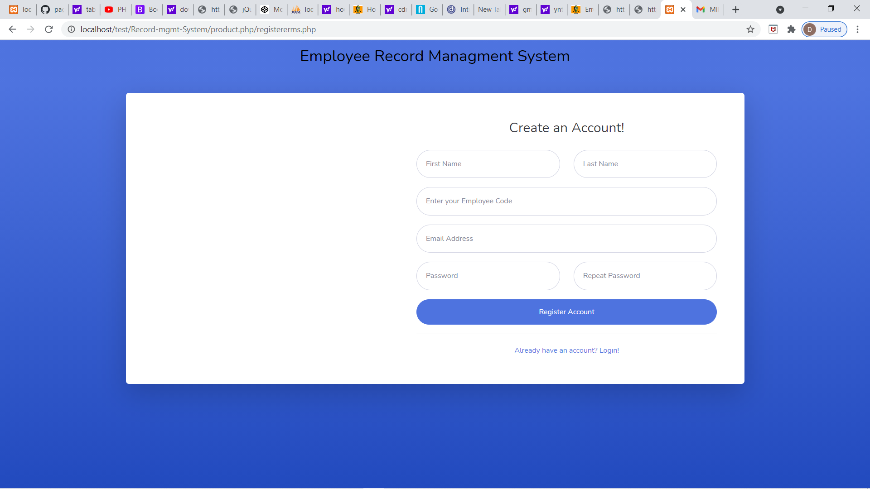
Registration of Employee

Slide 9
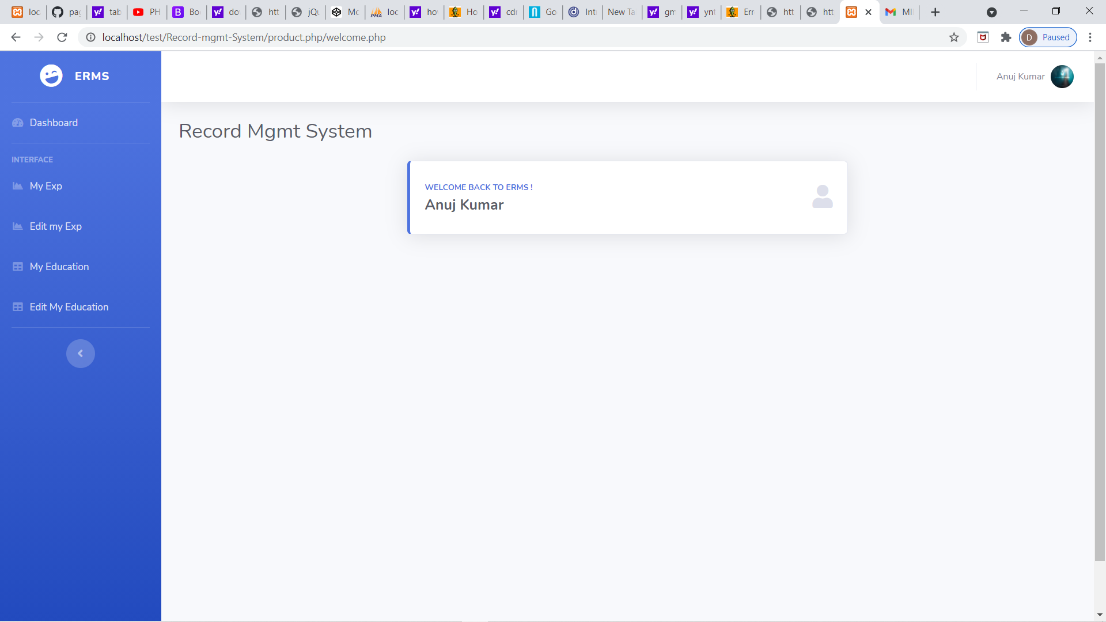
Employee Dashbord

Slide 10
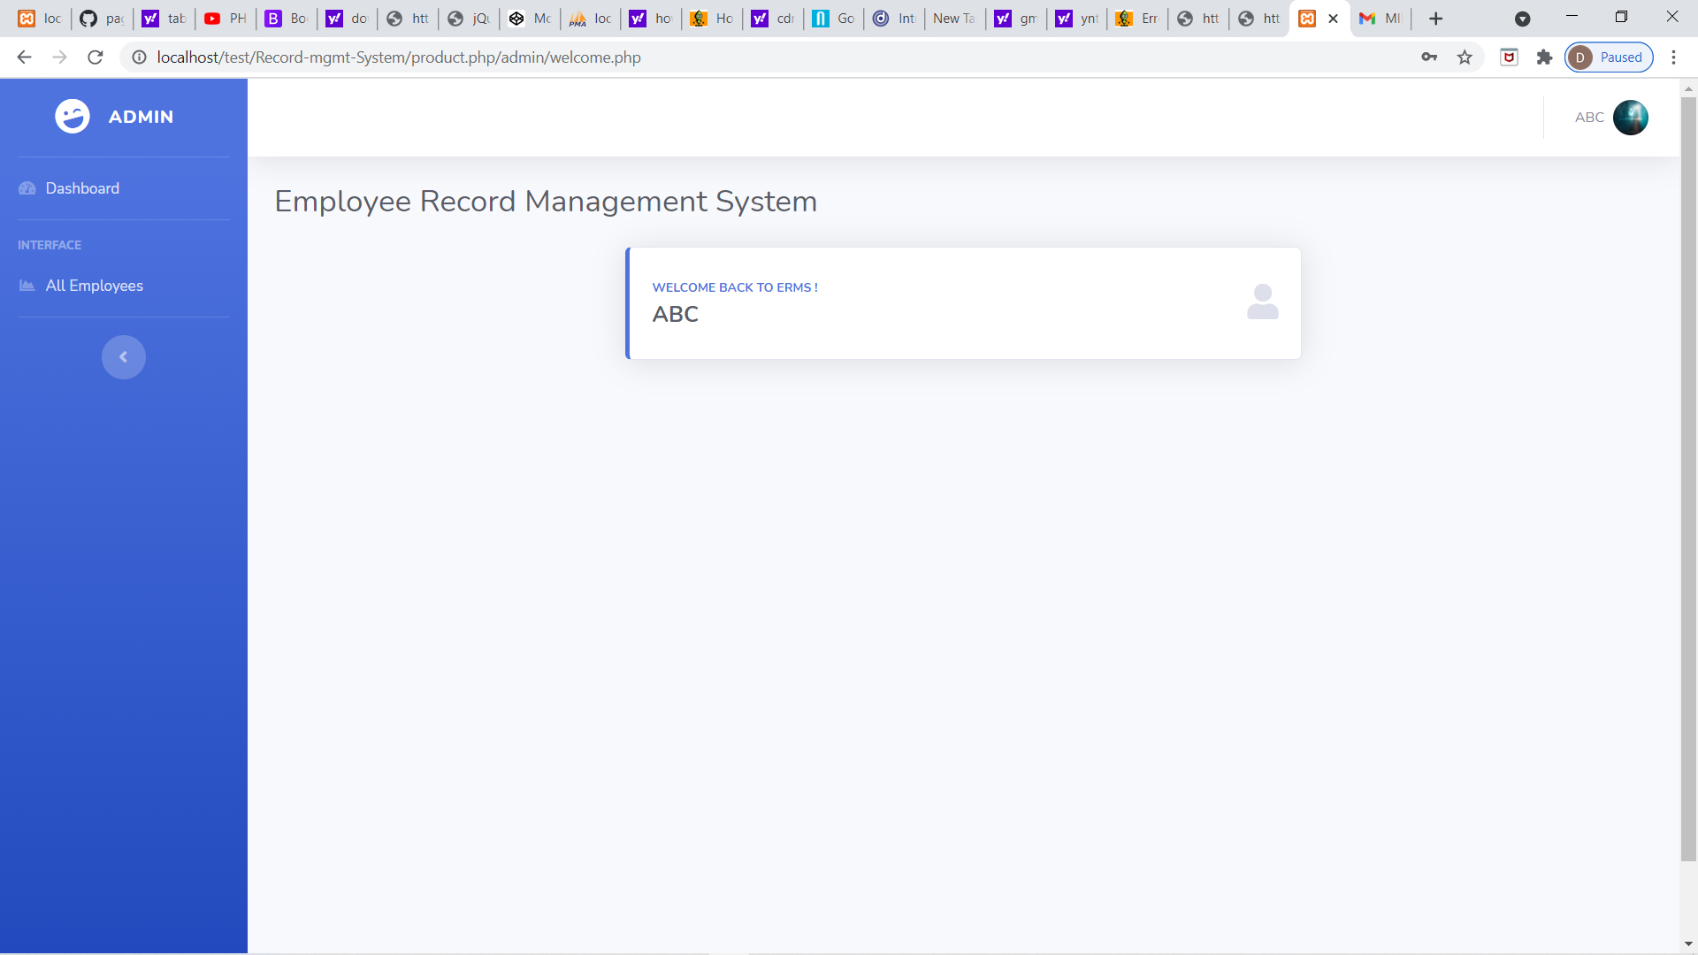

Slide 11
Advantages
Provides computerized system for maintaining records.
More efficient and reliable.
Less time consuming and easy to operate.
Huge data storage with less computer memory.
Avoid data manipulation, data inconsistency and redundancy.

Slide 12
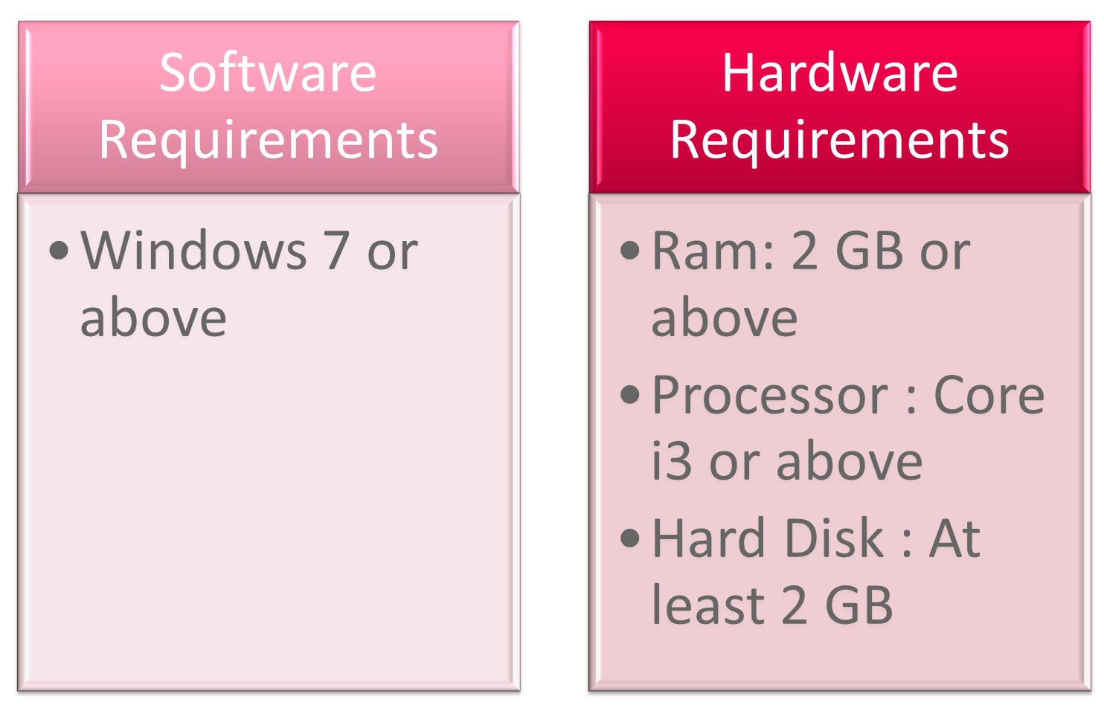
System Compatibility

Slide 13


